Slide 1


AirBNB Hotel Booking Analysis
Arushi Chaudhary
APPLY_175535193668a08b80c587a INTERNSHIP_17546440516895be537820f

Slide 2

PROBLEM STATEMENT
The hospitality industry has undergone a significant transformation with the rise of online platforms facilitating short-term lodging and tourism. Leading this revolution is Airbnb, Inc. Airbnb provides a diverse range of lodging options, offering guests a unique and personalized experience. Unlike traditional hospitality providers, Airbnb operates on a commission-based model, facilitating transactions between hosts and guests without owning the properties listed on its platform.
This research analysis delves to the New York City Airbnb dataset to extract meaningful insights. Through rigorous data cleaning, exploratory analysis, and visualization techniques, the study aims to illuminate the dynamics of the city's lodging market. By discerning factors influencing listing availability, pricing strategies, and overall customer satisfaction These insights hold significance for stakeholders and enthusiasts seeking to navigate the evolving landscape of short-term accommodation.

Slide 3
PROJECT DESCRIPTION
The Airbnb Open Data Analysis Project aims to explore and understand the factors that influence property listings, pricing, and customer reviews on Airbnb. By performing Exploratory Data Analysis (EDA) on a real-world dataset, this project provides valuable insights into the behavior of hosts, preferences of guests, and market dynamics across various neighborhoods. The dataset contains detailed information about each Airbnb listing, including property type, host details, location, room type, price, availability, number of reviews, and ratings. Through data cleaning, transformation, and visualization, patterns and relationships among these variables are identified.

Slide 4
The analysis addresses several key questions such as:
What are the most common property types listed on Airbnb?
Which neighborhoods have the highest number of listings?
How does the construction year relate to price trends?
Are verified hosts more likely to receive better reviews?
Is there a correlation between service fees and listing prices?
Do hosts with more listings maintain higher or lower availability?
By applying various visualization techniques such as bar charts, scatter plots, regression plots, and line charts, the project uncovers trends and relationships that help understand Airbnb’s hosting ecosystem. The insights derived can assist both hosts and guests in making data-driven decisions regarding property management and booking preferences.

Slide 5

WHO ARE THE END USERS?
The insights from this Airbnb Data Analysis project can benefit a wide range of stakeholders:
Hosts / Property Owners : To understand pricing trends, occupancy patterns, and factors influencing higher ratings, helping them optimize their listings and maximize revenue.
Travelers / Guests : To identify affordable neighborhoods, compare property types, and make better booking decisions based on reviews and availability.
Airbnb Management / Business Analysts : To analyze market trends, improve platform strategies, and enhance customer experience.
Students & Researchers : To explore real-world data relationships, practice EDA skills, and draw meaningful business insights from large datasets.

Slide 6

TECHNOLOGIES USED
Python – For data manipulation, cleaning, and analysis.
Pandas – To handle and analyze structured Airbnb datasets efficiently.
NumPy – For performing numerical and mathematical operations.
Matplotlib & Seaborn – For creating insightful visualizations and charts.
Google Collab – As an interactive environment for coding and visualization.
Excel – For data storage and initial exploration.

Slide 7
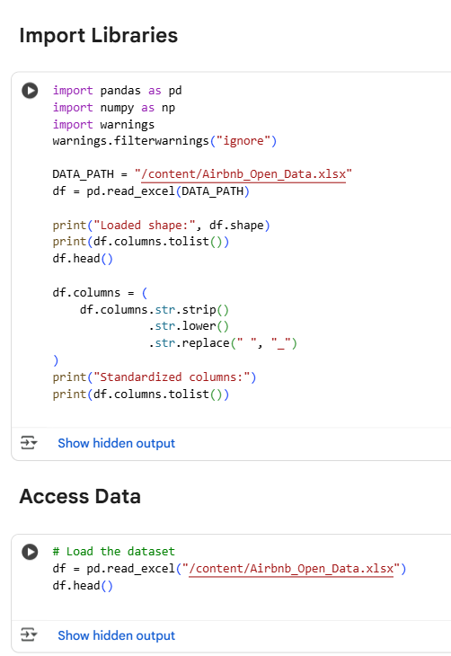
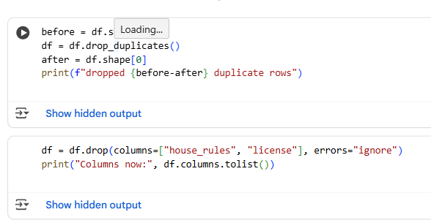
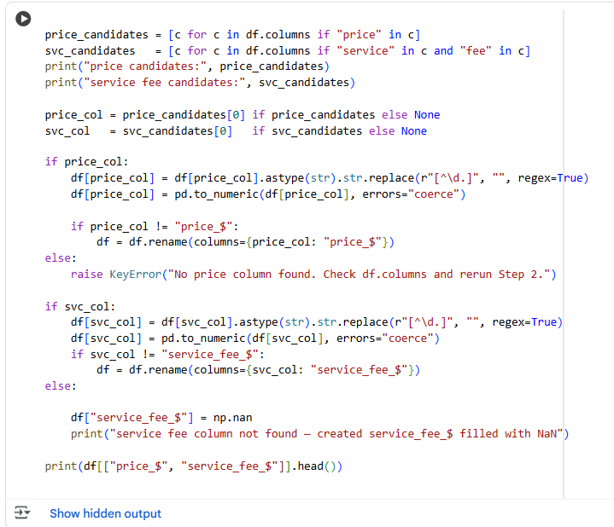
RESULTS
[code]
Google Colab Notebook: Click here to view my project

Slide 8
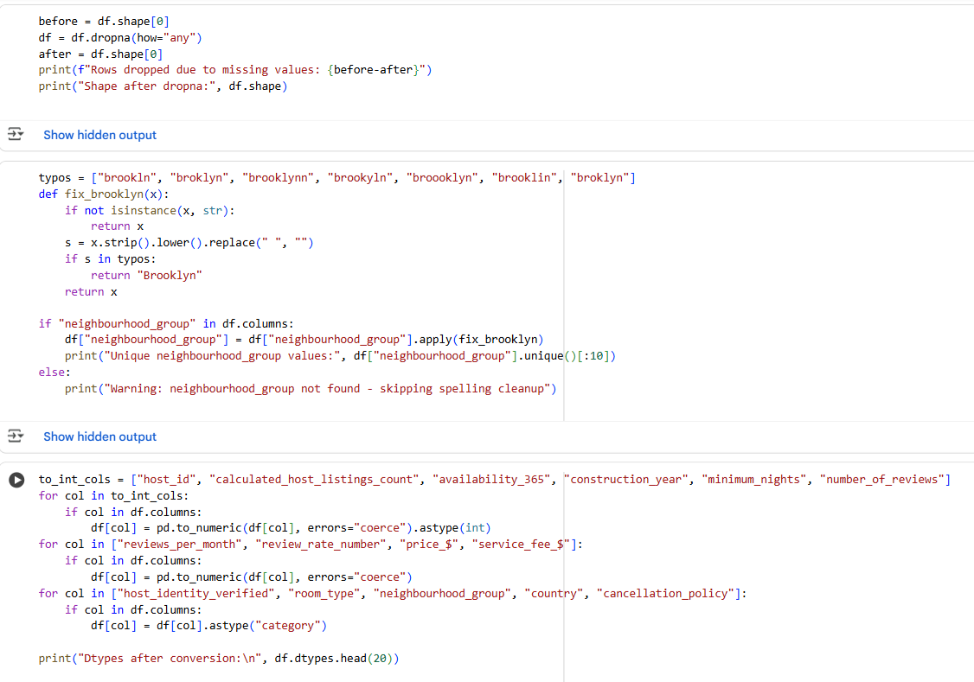
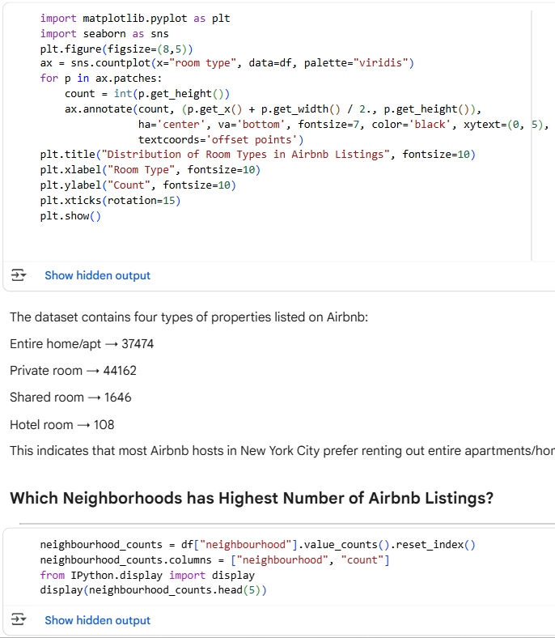
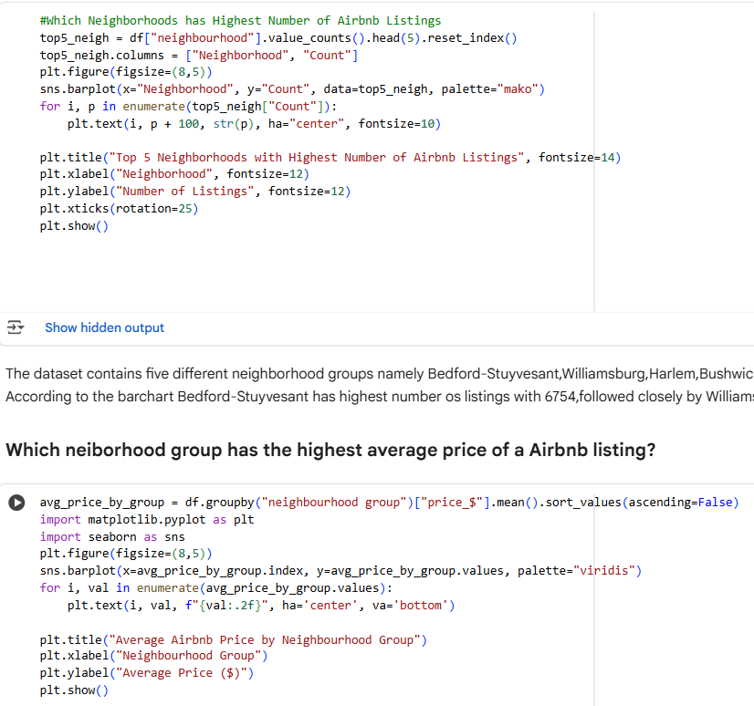
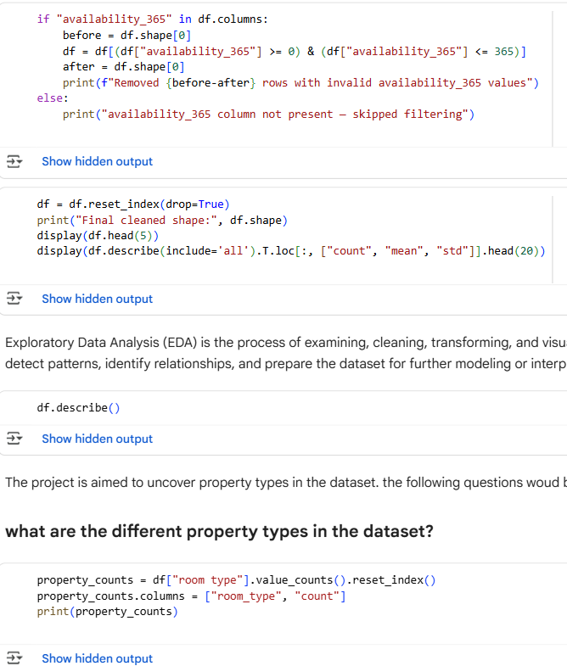

Slide 9
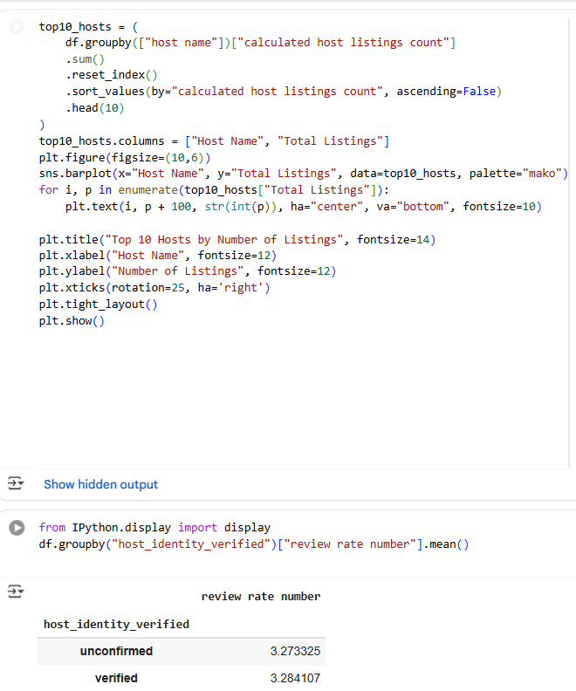
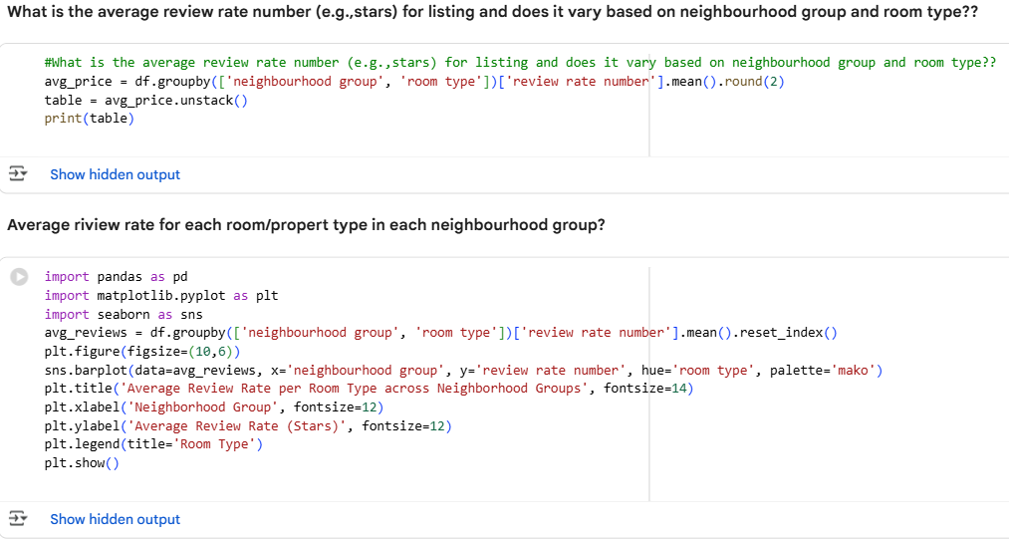
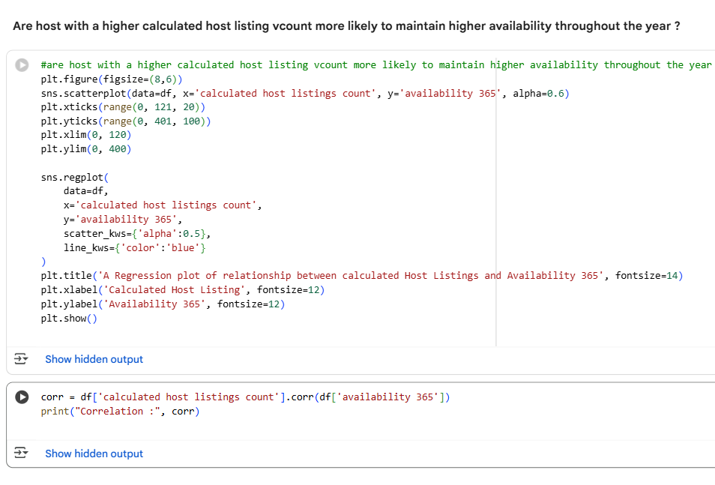
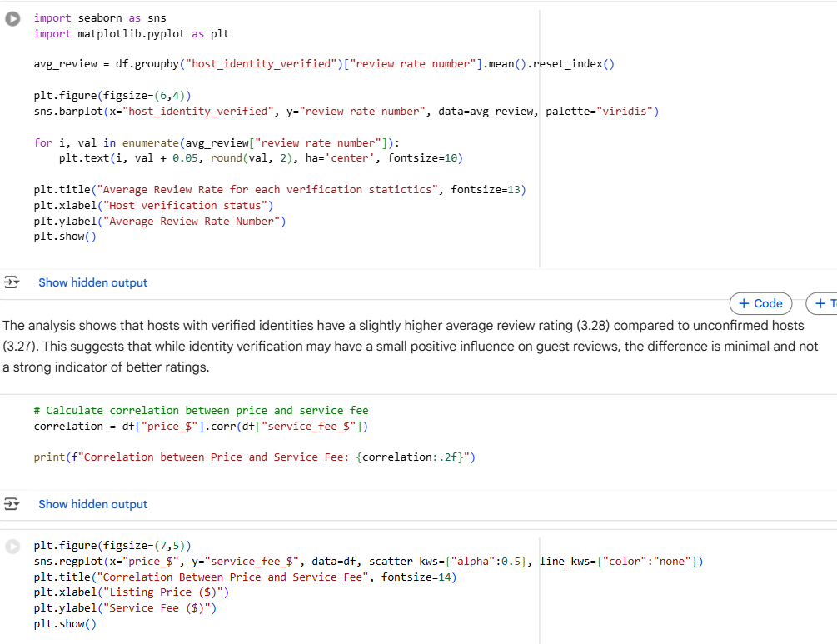

Slide 10
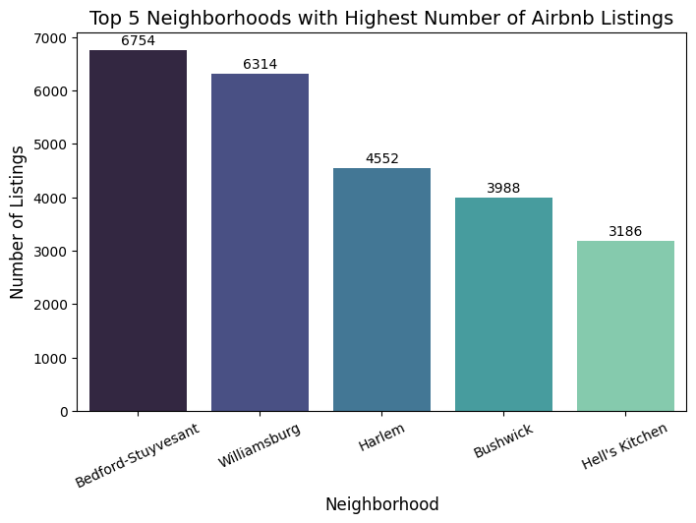
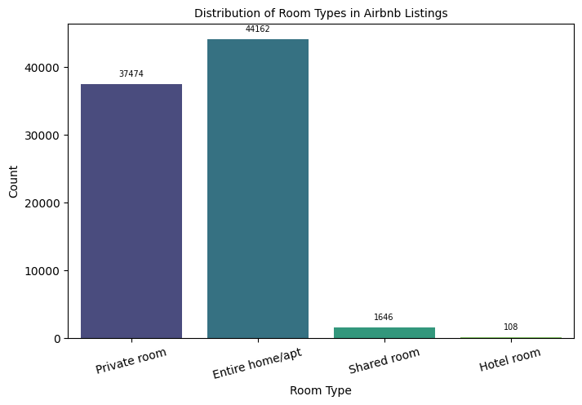
CHARTS

Slide 11
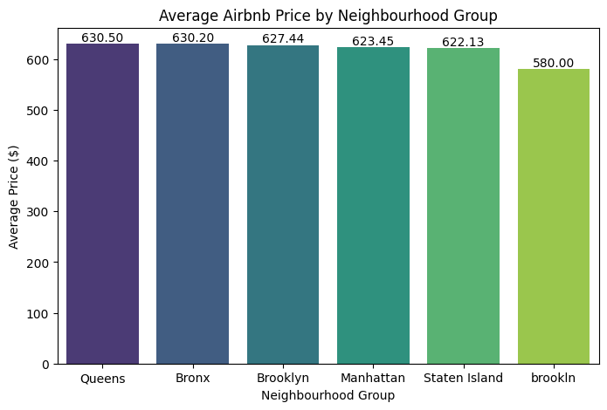
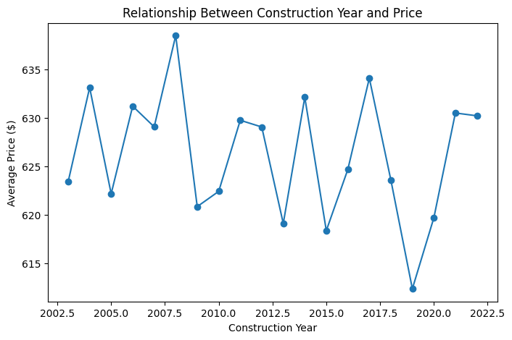

Slide 12
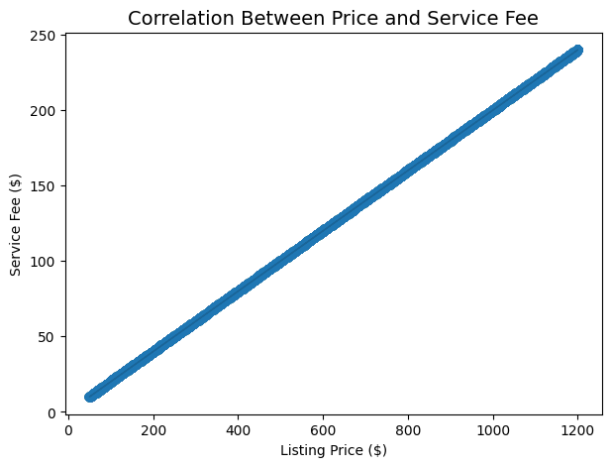
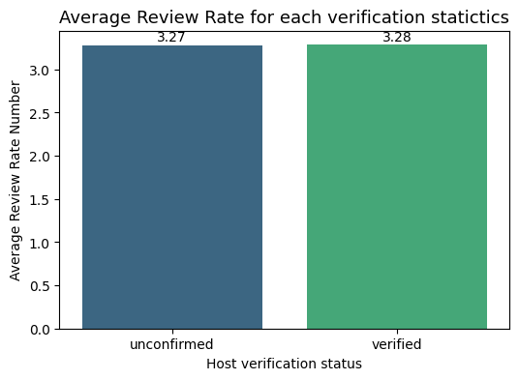

Slide 13
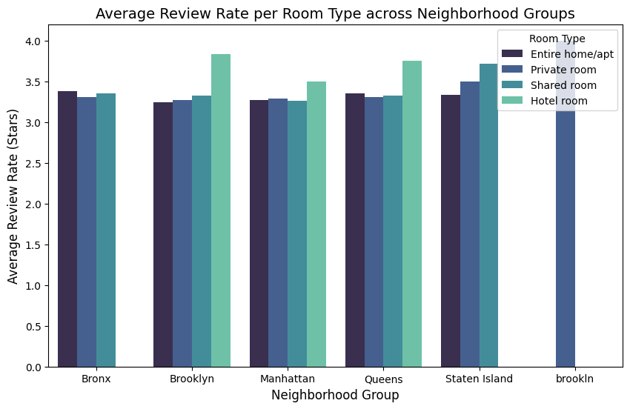
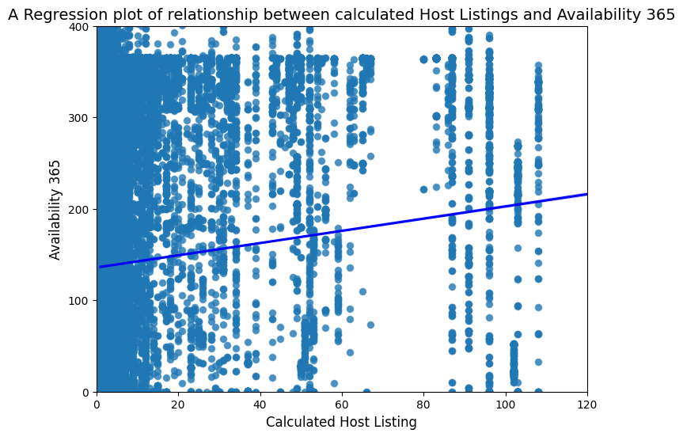

Slide 14


CERTIFICATES

Slide 15

Thank you!!
.
.

